Slide 1
Arithmetic for Computers
CSE-3109 Computer Architecture
Lecture 13

Slide 2

Addition and Subtraction
Let’s try adding 6_{ten} to 7_{ten} in binary and then subtracting 6_{ten} from 7_{ten} in binary.

Slide 3
Things to review: Binary Addition
Only four cases can occur in adding the two binary digits (bits) in any position.
They are
0+0=0
1+0=1
0+1=1
1+1=10=0 + carry of 1 into next position
1+1+1=11=1+carry of 1 into next position

Slide 4
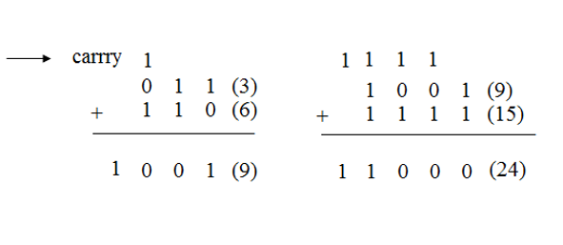
Things to review: Binary Addition Example

Slide 5
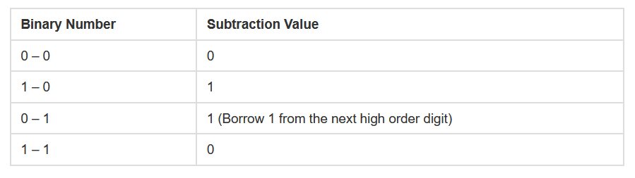
Things to review:
Binary subtraction Table
https://www.cuemath.com/numbers/binary-subtraction/

Slide 6
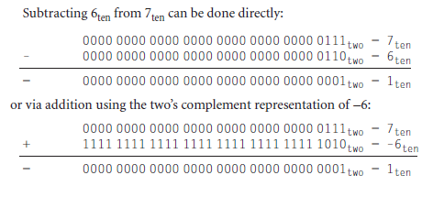
Addition and Subtraction

Slide 7
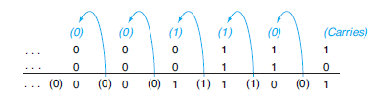
Binary addition, showing carries from right to left

Slide 8
Overflow during addition
Overflow occurs when the result from an operation cannot be represented with the available hardware, in this case a 32-bit word.
When adding operands with different signs, overflow cannot occur. The reason is the sum must be no larger than one of the operands.
For example, -10 + 4 = -6. Since the operands fit in 32 bits and the sum is no larger than an operand, the sum must fit in 32 bits as well. Therefore, no overflow can occur when adding positive and negative operands.

Slide 9
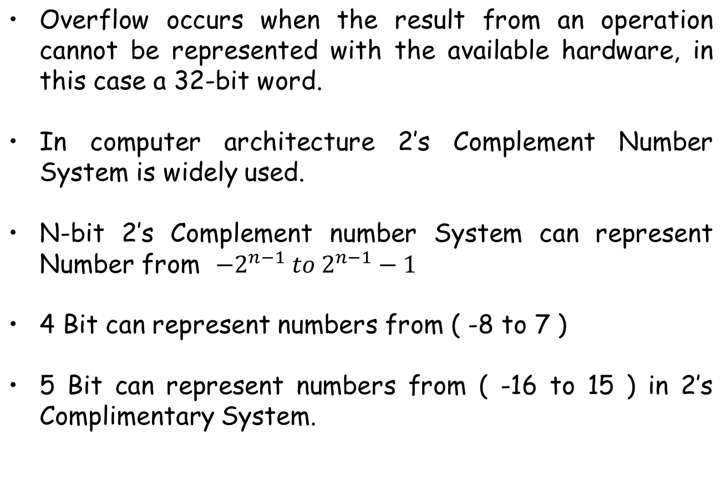
Overflow during addition

Slide 10
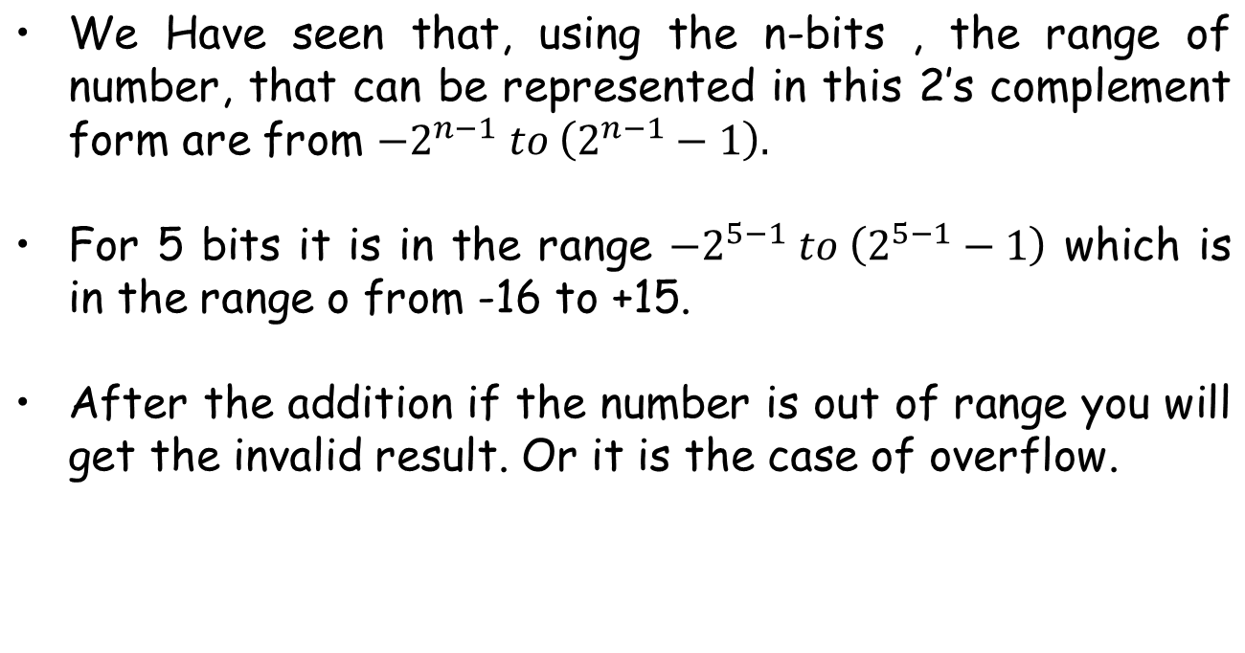
Overflow during addition

Slide 11
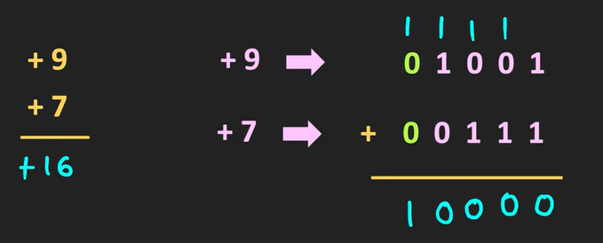
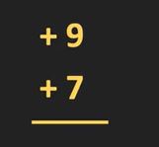
Overflow during addition
So through the example, let us understand the case of over flow. So let’s say we want to add two numbers plus 9 and the plus 7 using the 5 –bit 2’s complement arithmetic.

Slide 12
Overflow during addition
So through the example, let us understand the case of over flow. So let’s say we want to add two numbers plus 9 and the plus 7 using the 5 –bit 2’s complement arithmetic.
So first let us represent this two numbers in a 5-bit form. So this plus 9 can be represented as 0 1001.
So, Let us represent this two numbers in a 5 bit form. So this plus 9 can be represented as 0 1001. Similarly this plus 7 can be represented as 00111, And if we add these two numbers, then this 1 plus 1 is equal to 0, with 1 as a carry. Similarly , this 1 plus 1 is equal to 0 , and the carry equal to 1. Likewise this 1 plus 1 is 0, and the carry is equal to 1. Once again this is 1.

Slide 13
Overflow during addition
Likewise this 1 plus 1 is 0, and the carry is equal to 1. Once again this 1 plus 1 is 0, and the 1 is the carry. Therefore after the addition the number is 10000.
And after the addition, the result which you are getting is in fact invalid. The reason is that, the addition of the plus 9 and the plus 7 is equal to 16. And as you have just seen, and after the addition, the result which you are getting in in fact invalid.

Slide 14
Overflow during addition
The reason is that the addition of the plus 9 and the plus 7 is equal to plus 16. And as you have just seen, using the 5 bits, the maximum number which can be represented in the 2’s complement form is equal to 15. Therefore this addition will be always invalid. And even just by looking at the binary addition also, we can decide that whether this addition is correct or not.

Slide 15
Overflow during addition
So if we just look at the sign bits of this two numbers, then it is equal to 0. On the other end, If you see the sign bit of the result, then it is equal to 1, which indicates that the number is negative. Now here, we are adding the two positive numbers, therefore the result has to be positive. Or in other words, after the addition the MSB of the result should also be equal to 0.

Slide 16
Overflow during addition
But in this case, the MSB of the result is equal to 1. Which indicates that, this result is invalid. That means whether we are adding the two positive numbers, whose result is beyond the range of this n-bit Complement representation, then we will get the invalid result. And it is the condition of the overflow.
Hence, overflow occurs when adding two positive numbers and the sum is negative, or vice versa. This means a carry out occurred into the sign bit.

Slide 17
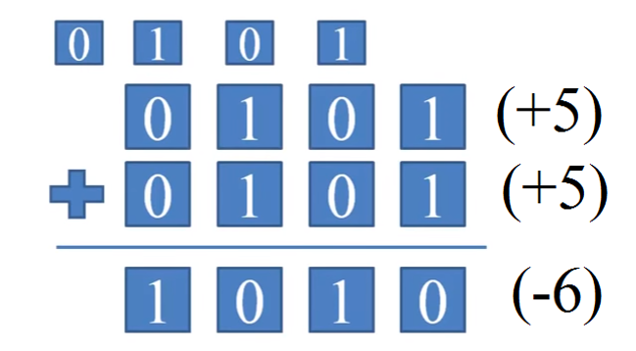
(Example)

Slide 18
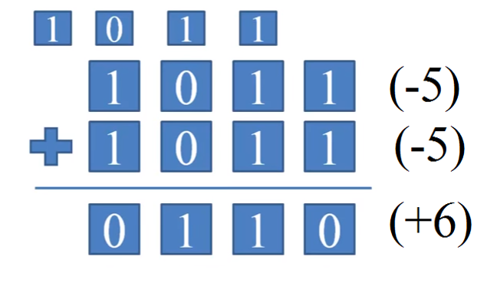
(Example)

Slide 19
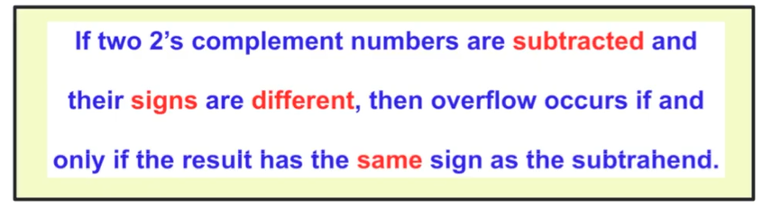
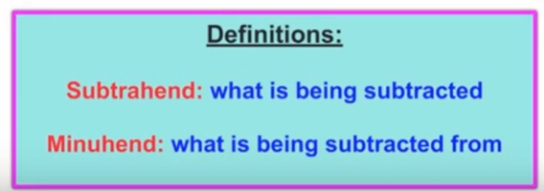
Overflow Rules for Subtraction
Overflow occurs in subtraction when we subtract a negative number from a positive number and get a negative result, or when we subtract a positive number from a negative number and get a positive result.

Slide 20
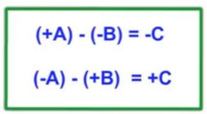
Overflow Rules for Subtraction
Here is the common notation for the overflow rule for subtraction. Two 2’s complement numbers they have different signs, and the overflow will occurred if the result has the same sign as the Subtrahend. So it can be seen, the resultant which is C is having the same sign as –B. For the second case the subtrahend is +B and the resultant is also +C.
https://www.youtube.com/watch?v=wy5FUYtY3P0

Slide 21
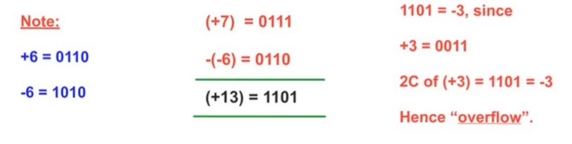
Overflow Rules for Subtraction
Since we are using 4 bits the number of range is -8 to +7. We need not represent +7 in 2’s complement because it is a positive number, only for negative numbers we do this 2’s complements representation.
+7is directly taken as 0111 and we need to represent -6 in 2’s complement, So +7 is directly taken as 0111. We know the binary representation of +6 is 0110, which means for -6 we got 2’s complement which is 1010.

Slide 22
Overflow Rules for Subtraction
Now we see that we need to subtract -6 from +7. So +7 – (-6). So we have to take 2’s complement of -6, that will become +6 actually. So we can directly represent +6 as 0110. That gives the result 1101 with decimal equivalent +13. The result is 4 bit, and the range of 4 bit we can accommodate the number is -8 to +7. Since the result is +13 it is very clear +13 cannot be accommodate in that particular 4 bit representation.

Slide 23
Overflow Rules for Subtraction
Here we can see that ‘1’ in 1101 represents negative number. Therefore 1101 is representing -3 because we know that +3 is 0011. 2’s complement of (+3) is 1101 which is -3 and here the resultant is also +13. That indicates that it is a “overflow”.
Here we can see that +7 is the minuend and -6 is the subtrahend. As per the rule what it says the overflow will occur if and only if the result has the same sign as subtrahend. We can interpret 1101 as -3 and -3 is having the same sign of the subtrahend ‘-’, so we can say that it is in overflow.

Slide 24
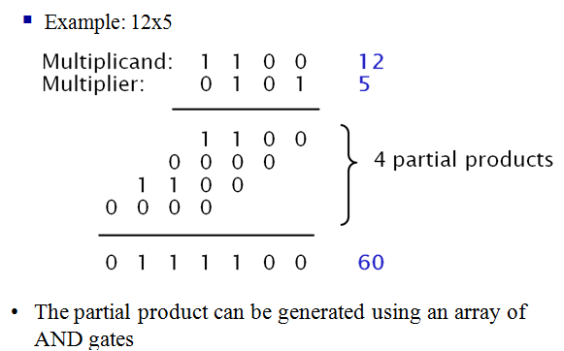

Slide 25
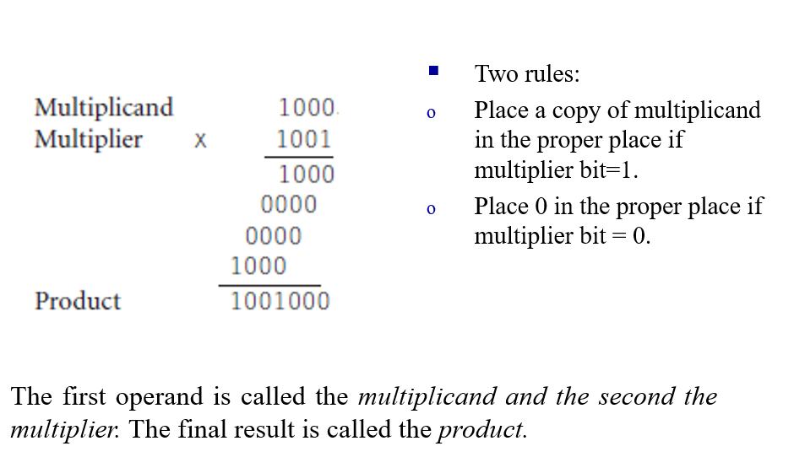

Slide 26
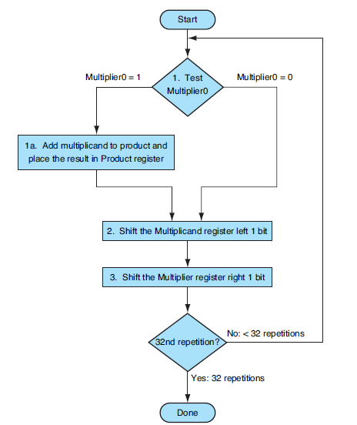
Sequential Multiplication Algorithm1

Slide 27
Sequential Multiplication Algorithm1
Figure previous slide shows the three basic steps needed for each bit. The least significant bit of the multiplier (Multiplier0) determines whether the multiplicand is added to the Product register.
The left shift in step 2 has the effect of moving the intermediate operands to the left, just as when multiplying with paper and pencil.
The shift right in step 3 gives us the next bit of the multiplier to examine in the following iteration.
These three steps are repeated 32 times to obtain the product. If each step took a clock cycle, this algorithm would require almost 100 clock cycles to multiply

Slide 28
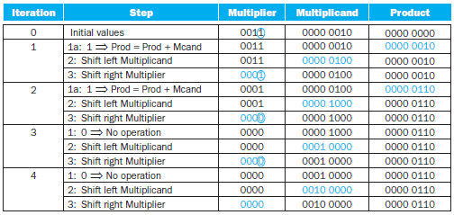
Example
Multiply 2_{ten} × 3_{ten}, or 0010_{two} × 0011_{two}.

Slide 29
End

